Slide 1
“To-Do Planner”
Task - 4

Slide 2

To-Do Planner
Our project focuses on delivering an efficient task management system with user-friendly features. It offers cross-platform accessibility for convenient task management on web and mobile devices. Collaborative capabilities enable users to share tasks and work together seamlessly. Additionally, customization options and goal tracking features provide a personalized and productive task management experience.
LMS Username | Name | Batch
Au721220104046 | Sindhuja.R | Cd1_14
Au721220104014 | Jeevitha.V | Cd1_14
Au721220104057 | Uma Karthikeyan.C | Cd1_14
Au721220104024 | Mitun.G | Cd1_14

Slide 3
Task-4
Creation of Backend
Using Node JS
For connection by using Postgres DB
Evaluation Metric:
100% Completion of the above tasks
Learning Outcome
Get to know about different lifecycle models.
Understanding importance and how to create an SRS
Knowing various commands of Github
Understanding agile and scrum management techniques for efficient product development

Slide 4
Step-Wise Description
Planning and Analysis: Define project objectives, scope, and user requirements, considering market research and budget constraints.
Design and Development: Create an intuitive UI with React for the front end and build Java-based server-side components.
Feature Implementation: Develop essential features, such as task management, collaboration tools, and goal tracking.
Testing and Deployment: Ensure reliability and security through rigorous testing, followed by successful deployment.
Maintenance and Enhancement: Continually gather user feedback and make updates to keep the To-Do Planner efficient and user-centric.
Summary of your task
The task involved providing information and guidance on developing a To-Do Planner project. This included creating a project title, defining a problem statement, proposing a solution, identifying technologies, and outlining key features. Additionally, we discussed the importance of a comprehensive To-Do Planner, technology choices (including Java), and key benefits. The task also involved outlining the development scope, step-wise description, and important project points. Finally, we crafted an introductory paragraph and summarized the project in various lengths, from multiple paragraphs to a few lines.

Slide 5
Assessment Parameter
Gather requirements for the project
add Readme.md file with description of the project
Prepare database design schemas
Check-List
Commit all changes with "first commit"
Get your initial project Structure ready
create a repository on github related to project
Initiate a git repository
Push your changes to github

Slide 6
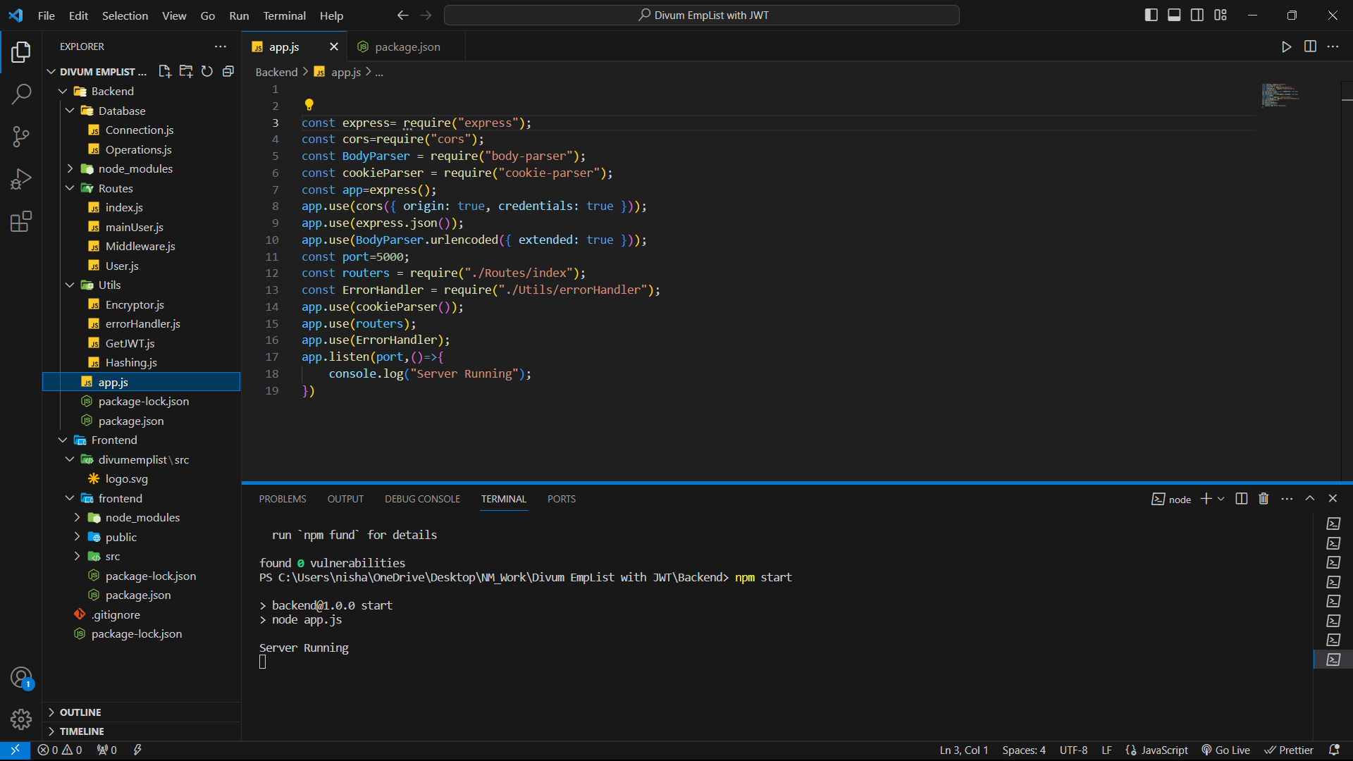
Running Status

Slide 7
Submission Github
https://github.com/20csa24
https://github.com/20csa13
https://github.com/SahiSindhu
https://github.com/Umakarthikeyan007

